Slide 1
Week 9. Totoro-Chat
Márton Lőrinczi
30.06.2017

Slide 2
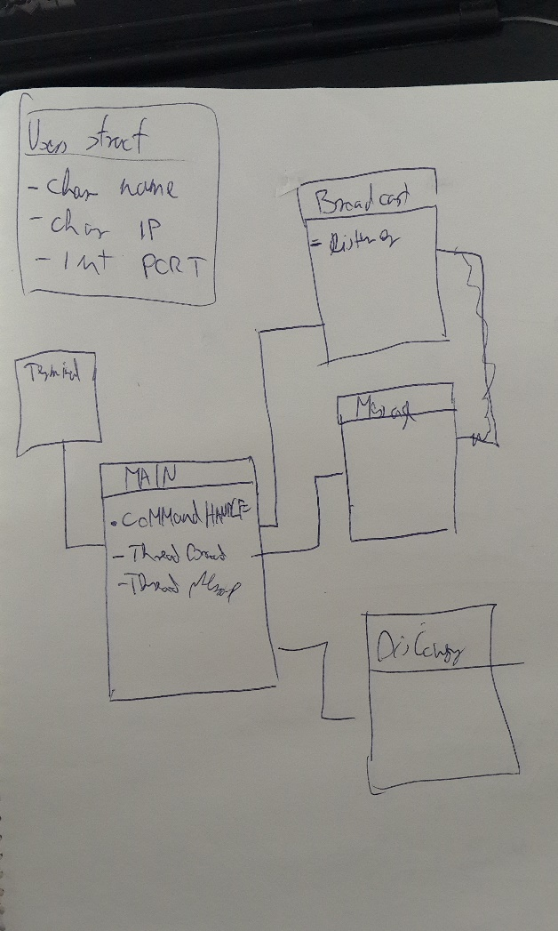
How did I see it at the begining

Slide 3
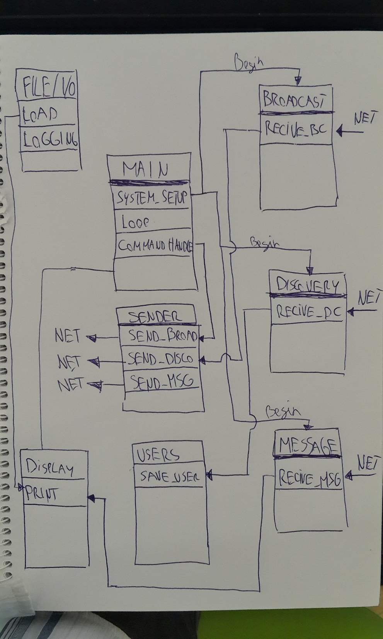
How I see it later

Slide 4
Under construction:
What did I finish from this project?
Users functions ( save, find, etc…)
Sender (broadcast message, simple message)
Broadcast listener
File I/O
Sender (discovery message)
Doscovery listener
Didn’t start yet:
Message listener
Display

Slide 5
What was the biggest „oohhh shhi” thing for me:
Users array should be global variable.

